Slide 1
Preparing for the AICP Exam
North Carolina Chapter of the American Planning Association
2023 State Planning Conference
Katherine Godwin, AICP
Vice President for Professional Development

Slide 2
Who is in the audience
Just want more information/ Considering AICP
Preparing for exam in November 2023
Preparing for exam in May 2024
Others?

Slide 3
Why? process Resources Subject Matter Preparation Effective test strategies questions

Slide 4
Why become certified?
Demonstrate Expertise
Get an Edge in the Job Market
Show Your Commitment to Ethics
Grow Your Career
Elevate Your Skills and Knowledge
Lead the Profession
Boost Your Professional Stature

Slide 5
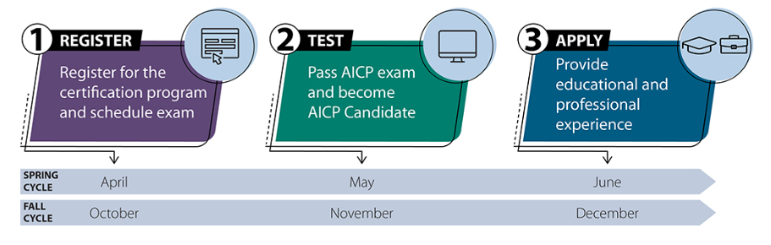
Steps to AICP Certification

Slide 6
Get Ready to Register ($255)
Have you joined APA/ Are you a Professional Planner?
Agree to abide by AICP Code of Ethics?
Able to confirm you Understand the Certification Requirements?
Will you be prepared to Test for the Upcoming Exam (May or November)?

Slide 7
Test ($0)
Must Register and Pay First- Eligibility ID
Schedule with Prometric Testing Center- Confirmation #
National Audience (i.e. no state specific questions)
170 Multiple Choice Questions of which 150 are Scored
3.5 Hours to Complete Test on Computer

Slide 8
Apply ($255)
Planning Process
Planning Processes
Skills/Practices
Project Example with Step Description
Evaluate Multiple Impacts
Planning Interventions
Community Consequences
Outcomes
Example
Public Decision-Making
Method of Influence
Type of Decision
Area of Public Interest
Example
* AICP Planning Experience Assessment Worksheet

Slide 9
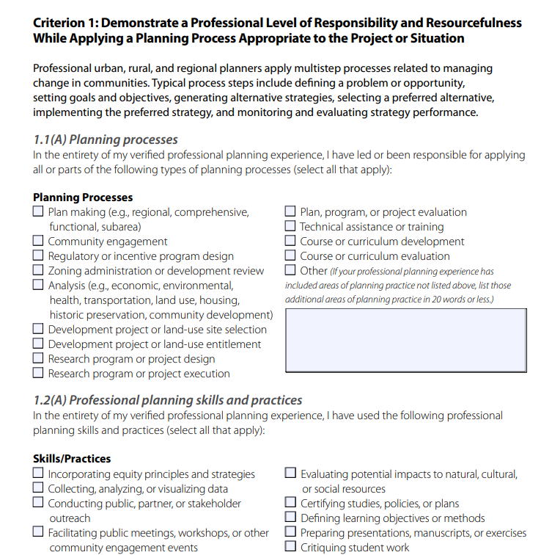
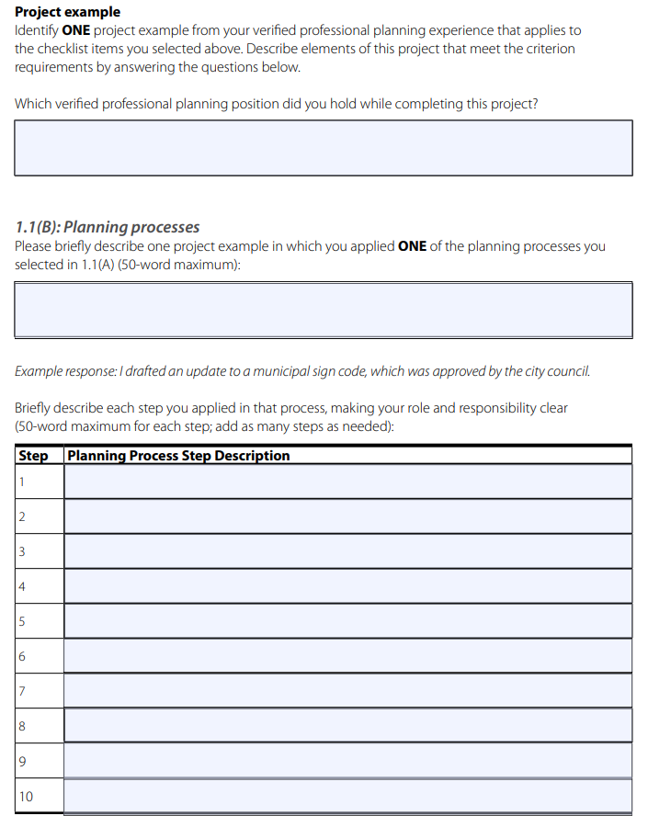

Slide 10
Education and Experience
Transcripts, Diploma, Formal Letter from School
Employer, Title, Dates of Employment, Full or Part Time, Supervisor Info, Summary of Tasks
Tools:
Planning Curriculum Worksheet
Interactive Experience Calculator
Planning Experience Worksheet

Slide 11
Planning Curriculum Worksheet

Slide 12
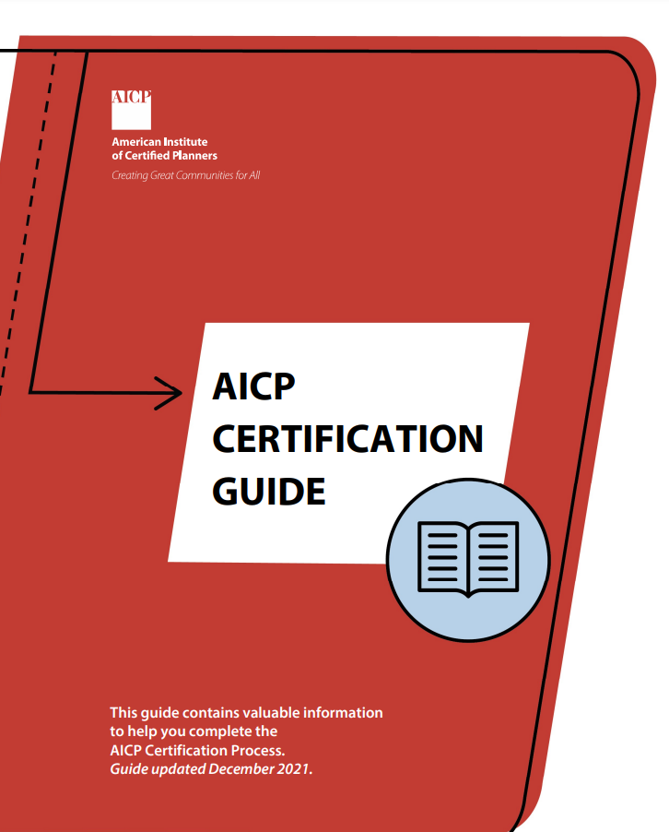
The AICP guides
Eligibility Requirements
AICP Certification Guide
Planning Curriculum Worksheet
Interactive Experience Calculator
Planning Experience Worksheet
Registration Details & Fees
Exam Details & Scheduling
https://planning.org/certification

Slide 13
The Exam Basics
3 hours and 30 minutes
170 questions
Online Proctored or On-Site
Score from 25-75 with 55+ Passing
You will Know Immediately if Pass or Fail
9 Areas of Subject Matter

Slide 14
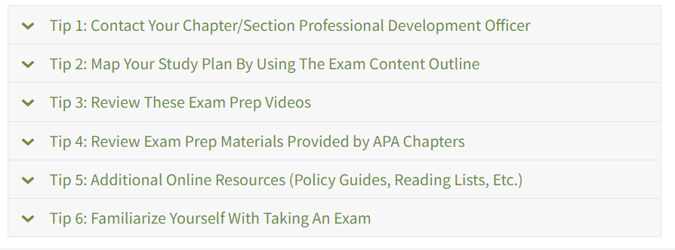
Exam tips

Slide 15
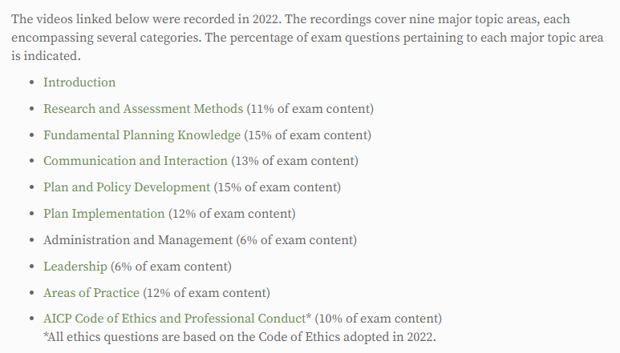
Training

Slide 16
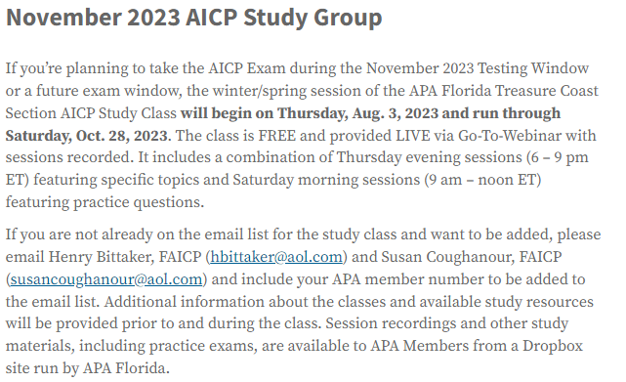
Chapters with guides/courses
Connecticut
Florida
Georgia
Iowa
Ohio
Pennsylvania
Texas

Slide 17
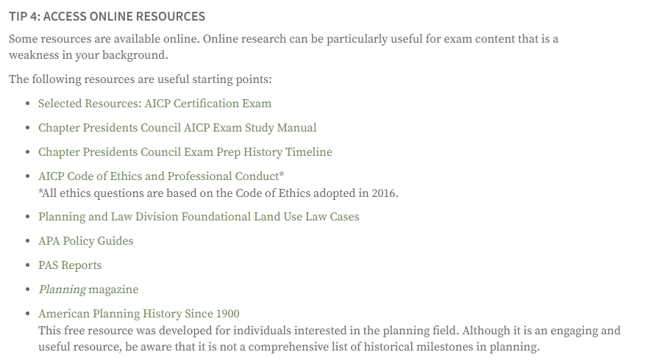
Online Resources

Slide 18
APA Policy Guides
Energy
Public Redevelopment
Billboard Controls
Impact Fees
Provision of Child Care
Food Planning
Agricultural Land Preservation
Homelessness
Smart Growth
http://www.planning.org/policy/guides
Notes:
APA develops policies that represent the collective thinking of APA’s members on positions of both principle and practice. The guides are developed through a process of chapter and division involvement under the overall guidance of the Legislative and Policy Committee. In addition to articulating specific policies that establish principles for better addressing planning issues, APA develops more specific guidelines that recommend specific actions on the part of APA members through leadership, chapters, divisions, and allied organizations that move toward an improved social and political environment for planning to play an effective role. Together, these two elements — policies and general recommendations — form APA Policy Guides.

Slide 19
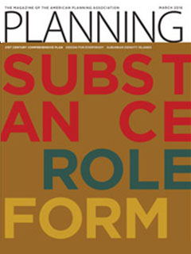
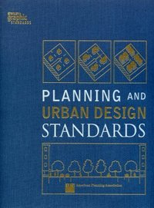
Select readings
www.planning.org/library/greatbooks/

Slide 20
Code of Ethics (10%)
KNOW THE CODE
Communications through the Ethics Officer
Adopted 2005; revised in 2009 & 2016 & 2021
Five Sections:
Aspirational Principles
Rules of Conduct
Advisory Opinions
Adjudication of Complaints of Misconduct
Discipline of Members
Source: ICMA
https://www.planning.org/ethics

Slide 21
Practice tests & Study Materials
FL-APA Treasure Coast Section Study Links
https://florida.planning.org/professional-growth/aicp-exam-preparation/
Study Stack
www.studystack.com
APA tutorial & reading list
www.planning.org/certification/examprep
Planning Prep Planning Peeps
www. planningprep.com planningpeeps.com/aicp-prep

Slide 22
Subject Matter

Slide 23
Subject emphasis
Research and Assessment Methods (11%)
Fundamental Planning Knowledge(15%)
Communication and Interaction (13%)
Plan &Policy Development(15%)
Plan Implementation (12%)
Administration, & Management(6%)
Leadership (6%)
Areas of Practice (12%)
AICP Code of Ethics & Professional Conduct(10%)
http://www.planning.org/certification/examprep/subjectmatter.htm

Slide 24
Research and Assessment Methods (11%)
Conducting research and acquiring knowledge
Data and source interpretation and evaluation
Spatial analysis
Community involvement and engagement
Data collection strategies appropriate to identifying planning issues while acknowledging privacy and confidentiality concerns

Slide 25
Fundamental Planning Knowledge (15%)
History of planning, planning movements, and influences on contemporary planning
Patterns of human settlement
Foundational legal principles and statutory basis of planning
Planning Theory
The general terminology, practices, and principles of related professions
Natural, social, and economic systems
Core values of planning
How technology can be used to advance planning
Information technology tools

Slide 26
Communication and Interaction (13%)
Communication
Strategies and techniques to provide non-discriminatory electronic media free of obstacles and/or barriers to accessibility.
Listening, comprehension, and reflection of needs and ideas
Leadership
Social justice
Culturally appropriate and respectful communication sensitive to cultural history and social movements
The processes and techniques involved in working towards consensus for decision making
Understanding the role of organizational structures and functions
Outreach strategies and techniques for various communities, particularly that best suit engagement needs of the disenfranchised or marginalized community
Evaluation of how well the planned outreach strategy actually engaged targeted communities/populations
Evidence-based argument formulation and articulation
Sensitive or complex political situation management

Slide 27
Plan and Policy Development (15%)
Preparing to plan
Planning as characterized by sequential steps and multi-variate analyses
Familiarity with states' and federal laws
Formulating and drafting policies
Vision, goal, objective, policy, and priority statement creation and their interrelationships
Objectives and actions to address identified needs and priorities within an equity framework
Stakeholder and community inclusion in scoping a plan, policy, and project
Mediation, negotiation, facilitation, or arbitration in order to address conflicting interests and demands
Applying innovations and best practices appropriate to place and context
Identifying and evaluating consequences
Funding and financing considerations, demands, and strategies
Community character and form
Identifying, quantifying, and addressing incidence and burden, past and future, that results from systems that foster and perpetuate inequities and discrimination
Conversance with related disciplines

Slide 28
Plan Implementation (12%)
Develop and interpret rules, regulations, policies, and programs
Aligning and activating funding and financing options
Proposal or project assessment for consistency with adopted programs and plans, laws, regulation, and policy
Developing strategic partnerships to facilitate plan implementation
Identifying and mitigating challenges and obstacles for plan implementation
Drafting action steps and assigning responsibility including managing, facilitating, and/or coordinating the implementation of programs or projects according to a schedule
Monitoring, evaluating, and updating adopted plans and policies in order to achieve the greatest benefits with no or minimal adverse impact
Integrating multiple projects to achieve efficiency, effectiveness, and synergy

Slide 29
Administration and Management (6%)
Project or program management
Internal organizational management
Management of external relationships in a manner considering transparency, freedom of information, confidentiality, privacy, etc.
Mentoring and motivating staff to develop their skills optimally, and to ensure timeliness, accuracy, and clarity of work produced
Results oriented management and accountability

Slide 30
Leadership (6%)
Leadership in support of plan making, participation, recognition of needs, and commitment action
Ethical aspects of advocacy
Best practices and their potential applications
Accountability to the profession, ethical principles and the public interest
Institutional structures, including accountability, transparency expectations, and roles and responsibilities
A planner's comprehensive approach to complex problem solving and decision-making
The ethics of equity, diversity, and inclusivity in practice
Coaching and mentoring
Discerning and promoting the public interest related to a proposed action
Professional development expectations and standards and sharing opportunities
Discerning and promoting the value of planning to others, including students, coworkers, decision makers, and the public
Opportunities to promote and volunteer in professional planning organizations and planning related services in the community

Slide 31
Areas of Practice (12%)
Comprehensive & sectoral planning
Community, subarea, corridor, & neighborhood planning
Current planning
Sustainability planning
Transportation planning
Infrastructure planning
Hazards, mitigation, & resiliency planning
Environmental & natural resources planning
Economic development planning
Urban design
Housing planning
Parks, recreation, & open space
Historic & cultural resources planning
Institutional planning & siting
Food planning
Health planning
Rural & small town planning
Equity Planning
Regional Planning
More…

Slide 32
Preparation

Slide 33
Preparation
BEFORE THE TEST
FOR THE TEST
Study early & often
Use practice tests
Be strategic/Have Plan
Focus on weak areas
Use the best method of studying for your style
Schedule your test site ASAP
Get a good night’s sleep
Arrive early
Bring 2 forms of ID
Dress comfortably (layers)
Bring a survival kit
DON’T FREAK OUT
Notes:
100 hours

Slide 34
Test Strategies

Slide 35
3 hours & 30 minutes…
BREATHE
15-minute tutorial at test site occurs before test begins
170 questions (150 count)
Keep a rhythm, pace yourself
ANSWER EVERY QUESTION
Mark questions to come back to later
When in doubt, guess
55+ is passing, tests are scaled, questions vary in value
http://www.planning.org/_offsite/certification/tutorial/

Slide 36
If you don’t pass…
DON’T PANIC!
You are not alone
Schedule your retake (re-apply if needed)
Review your score report, identify weak areas
STUDY, STUDY, STUDY

